Slide 1
Jermyn Borough Council Meeting
07/18/2024

Slide 2

Meeting Agenda
July 18,2024
CALL TO ORDER
PLEDGE OF ALLEGIANCE
ROLL CALL
PREVIOUS MEETING MINUTES
TREASURER REPORT/BILLS PAYABLE
SECRETARY REPORT
CORRESPONDENCE
PUBLIC COMMENT
PROFESSIONAL REPORTS-POLICE, FIRE, SOLICITOR, ZONING, ENGINEER, TAX COLLECTOR, MAYOR
COMMITTEE REPORTS-SAFETY, PLANNING, FINANCE, SHADE TREE, REC, MS4, DPW
NEW BUSINESS

Slide 3
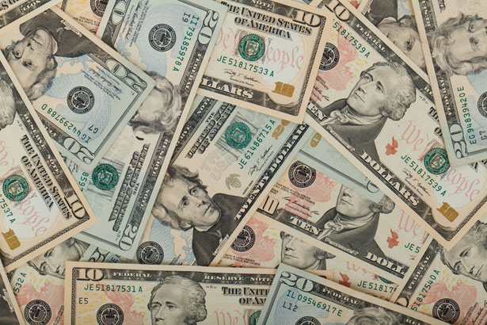
Treasurer’s report
7/18/2024
ASSETS
Checking/Savings
American Rescue Plan Fund 135,760.91
Capital Reserve - DPW 909.60
Capital Reserve - Police 5,859.82
Crime Watch Fund 222.69
General Fund - Community 221,218.31
General Fund - FNB 5,969.71
Holiday Lights Fund 300.59

Slide 4
Treasurer’s report
Investment - General Fund 1,092.74
Investment - Liquid Fuels 24,059.93
Investment - Paving Fund 1,104.12
Investment - Recycling 120.68
Investment - Refuse 172.08
Liquid Fuels - FNB 38,334.71
Petty Cash 196.50
Recreations Fund 23,329.19
Recycling - Community 3,468.14
Refuse Checking - FNB 232,835.15
Total Checking/Savings 694,954.87

Slide 5
Treasurer’s report
200000 · Accounts Payable 88,551.59
Long Term Debt 161,370.37

Slide 6


